Slide 1

Store Sales Forecasting
Walmart
Jesus Mendoza
Brian Canela
Juan Rojas
Abraham Vega
Gian Tolentino
Data Science | Fall 2018 | Nov. 30, 2018

Slide 2
Project Description
Given sale data of 45 Walmart stores in different regions, we were tasked to project sales per week for each department in each store.
Holiday markdown events are included, as these affect sales differently between each department.
Notes:
The last sentence can be clarified more as we present to class.

Slide 3
Data Details
Stores.csv
Anonymized info about 45 stores, type and size of store
Features.csv
Additional data related to store, department and regional activity. Contains: Store, Date, Temperature, Fuel_Price, Markdown 1-5, CPI (consumer price index), unemployment, and IsHoliday
Data.csv
Historical data with the fields: Store, Dept, Date, Weekly_Sales, and IsHoliday
420k rows
Merged the Data into One dataset as a inner join on Store ID.

Slide 4
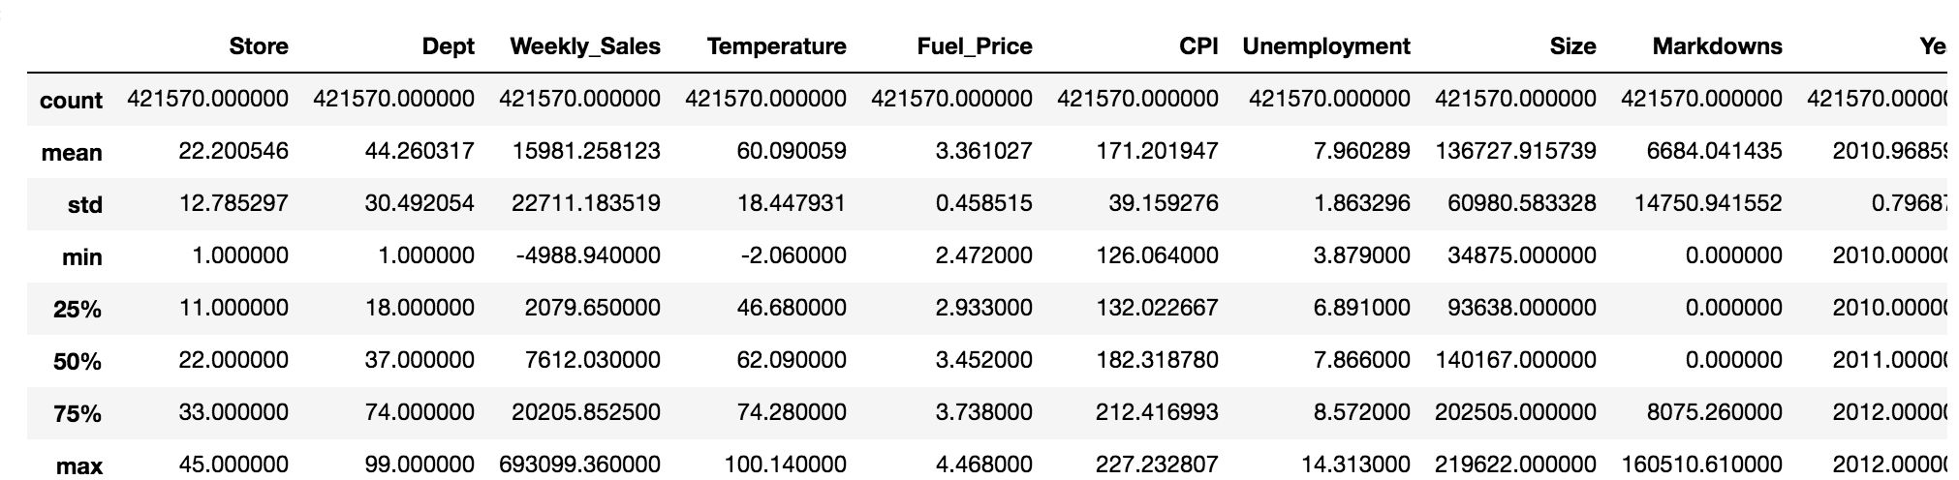
How we started working on the project?
With our Dataset we looked at what our dataset looks like with the help of the describe function in Python.

Slide 5
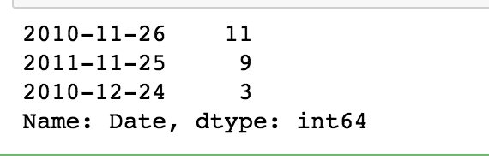
Exploring Data Analysis
Based on the previous image, we fetched data based on highly top weekly_sales dates with value counts next to the date.

Slide 6
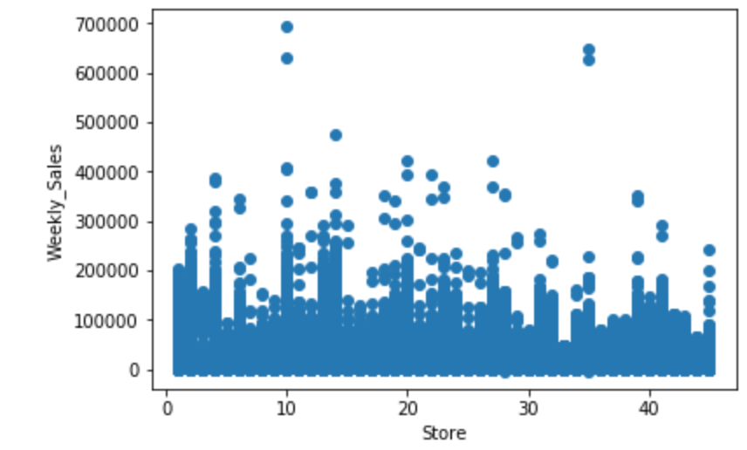
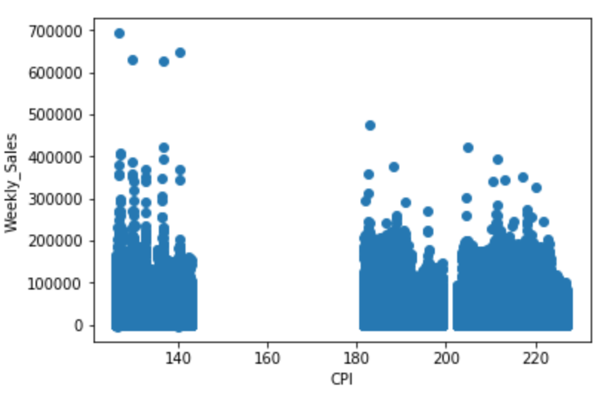
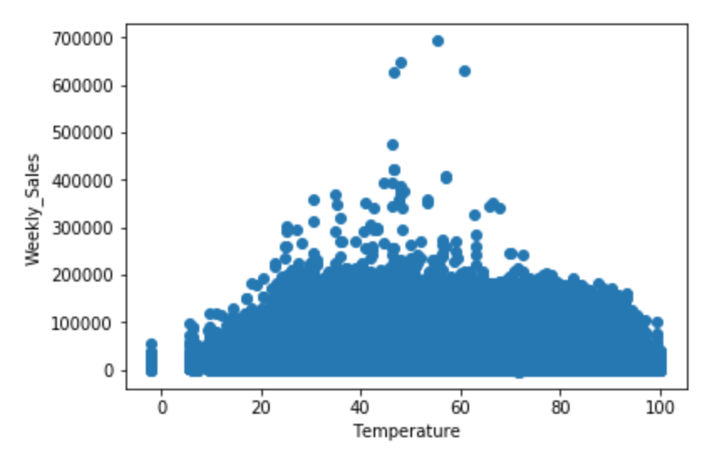
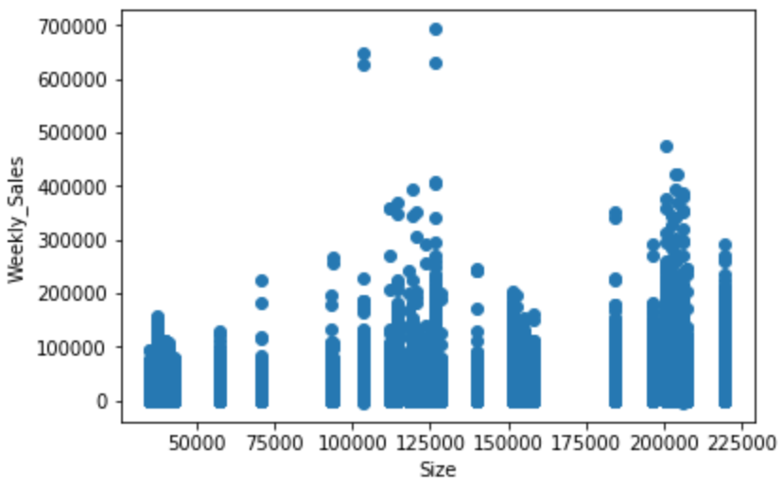
Weekly_Sales vs Store ID
Weekly_Sales vs CPI
Weekly_Sales vs Temperature
Weekly_Sales vs Store Size

Slide 7
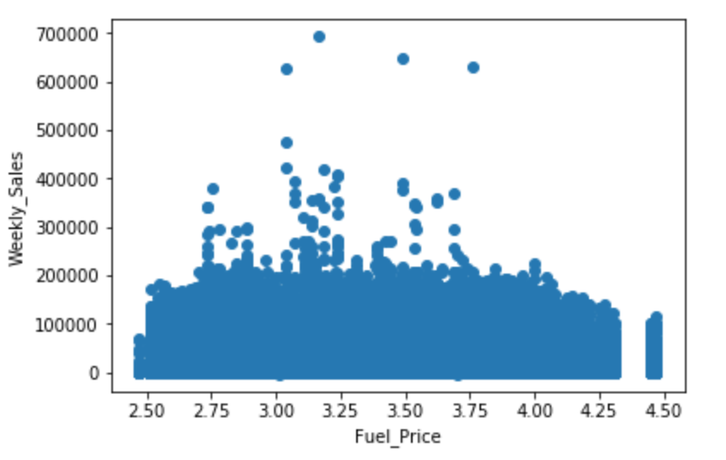
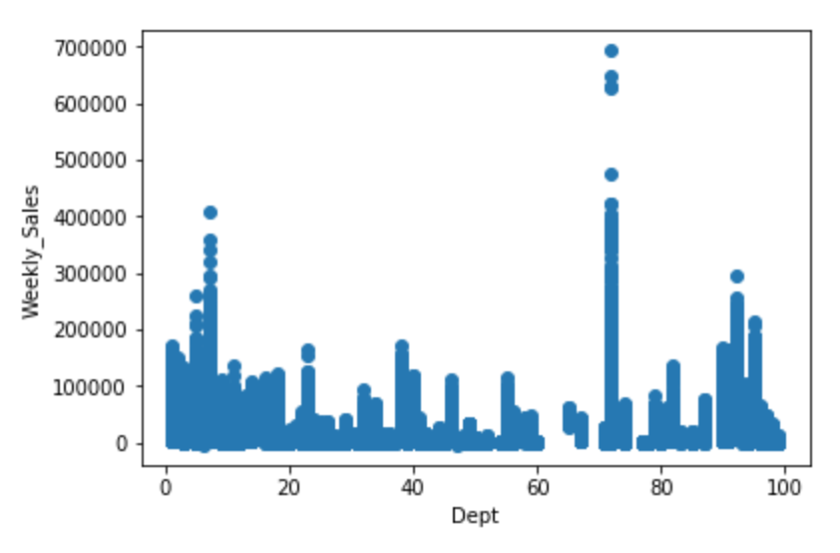
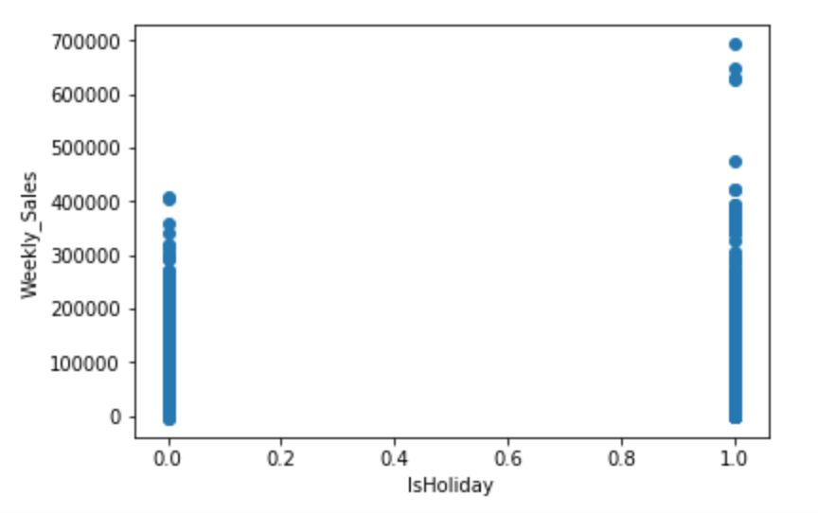
Weekly_Sales vs Fuel Price
Weekly_Sales vs Store Department
Weekly_Sales vs isHoliday

Slide 8
Methods and Algorithms
Linear Regression with coefficients and RMSE
Decision Tree Regression
Random Forest Regressor
Logistic Regression with Cross Validation
Feature Reduction by Principal Component Analysis
Notes:
Need to add accuracy of these

Slide 9
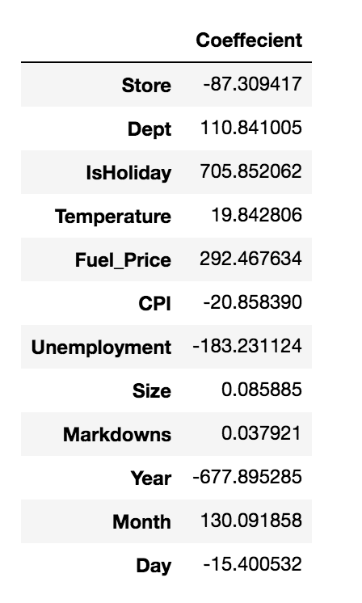
Linear Regression for Weekly Sales
weekly_sales = 1366427.618−87.309×Store+101.841×Department+705.852×IsHoliday+19.842×Temperature + 292.467×FuelPrice−20.858×CPI−183.231×Unemployment+0.0859×Size+0.0379×Markdowns−677.895×Year+130.009×Month−15.400×Day
Most important feature is the ‘IsHoliday’, meaning weekly sales depended mostly on the week where a holiday took place.
Holidays taken into account : Super Bowl, Labor Day, Thanksgiving (Black Friday , Cyber Monday) , and Christmas.
Least important feature was Size.

Slide 10
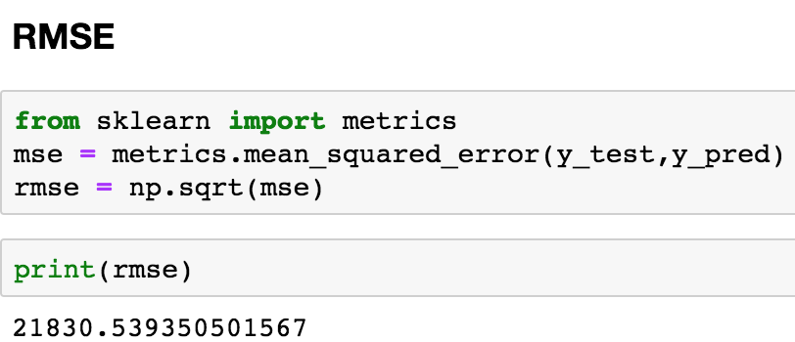
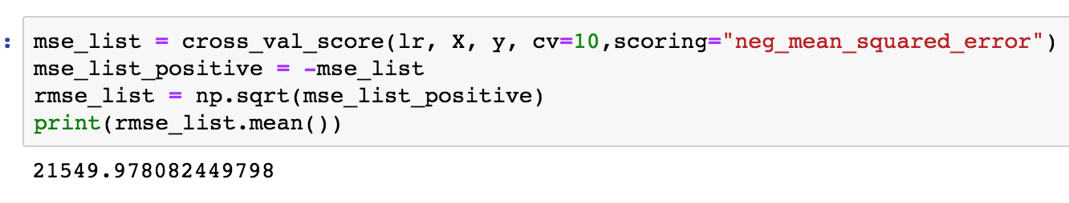
Evaluating Linear Regression Model
Metric used to quantify the error is RMSE and CV.
Root Mean Square Error.
10-fold Cross Validation

Slide 11
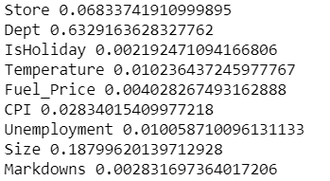
Decision Tree Regression
Why not Decision Tree Classifier?
Regression trees are used when response variable is numeric or continuous.
They can be used for predictions
Determined “IsHoliday” is the most important feature
Accuracy of 95%

Slide 12
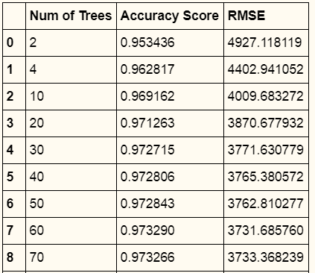
Random Forest
Used various n_estimators to verify the optimal number of trees
60 trees allowed for the most optimal r2_score and RMSE value
r2_score : 0.9732900408513572
RMSE: 3731.6857603676544

Slide 13
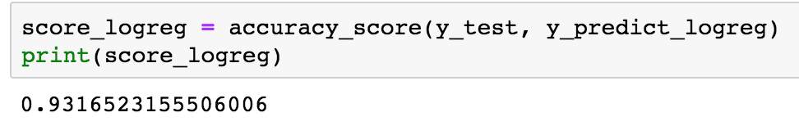
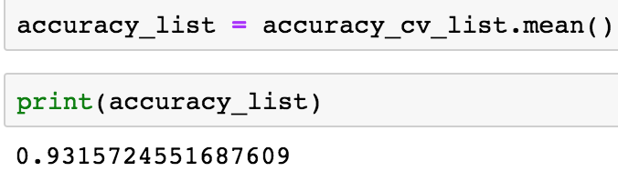
Logistic Regression With Cross Validation
Used feature “IsHoliday” for the label.
Evaluation of Accuracy
Using Accuracy Score for Logistic Regression.
Using 10-fold Cross Validation:

Slide 14
PCA
PCA : Principal Component Analysis
What we did:
Modified the ipynb files, with the machine learning algorithms, it to perform pca
For each algorithm, I test all possibilities of PCA and measure their accuracy / error and compare them to find the optimal # of c
Then we can see how feature reduction affected the accuracy / error, and how much we can improve it based on the number of components we reduce it to.

Slide 15
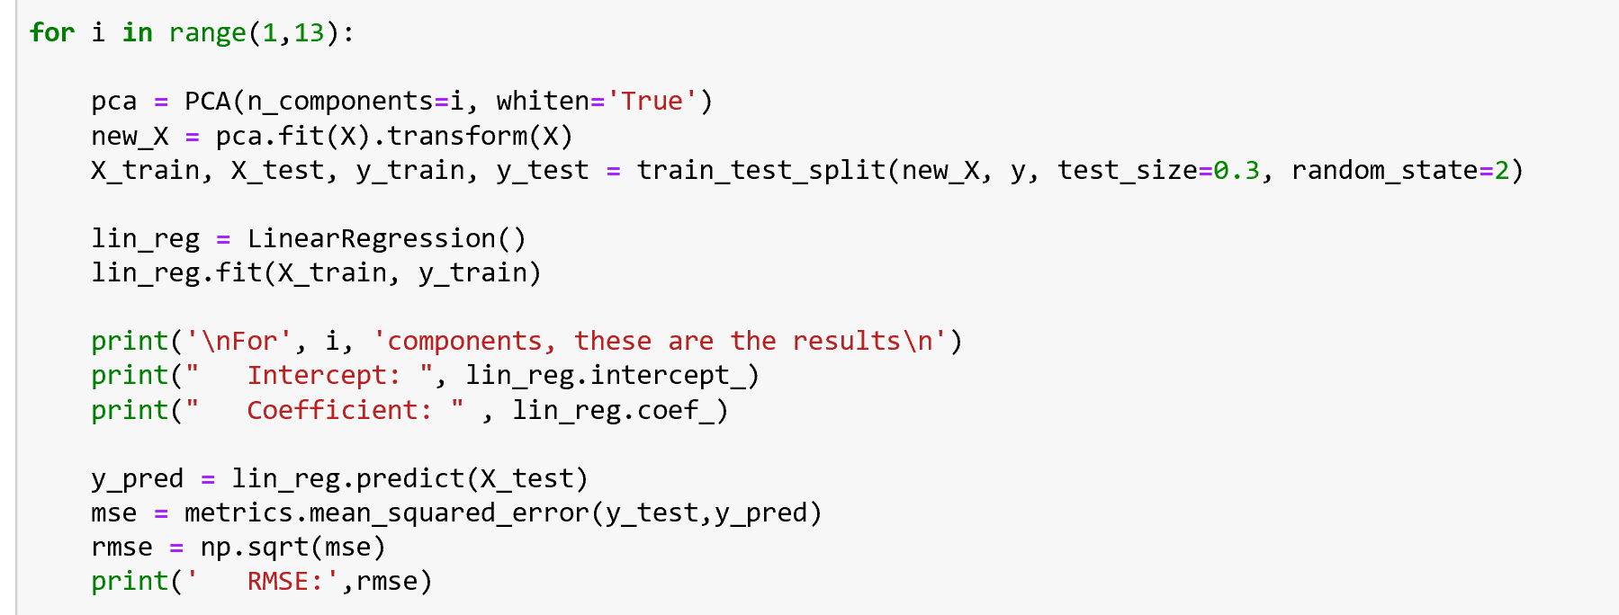
PCA on Linear Regression
The performed PCA as shown below:

Slide 16
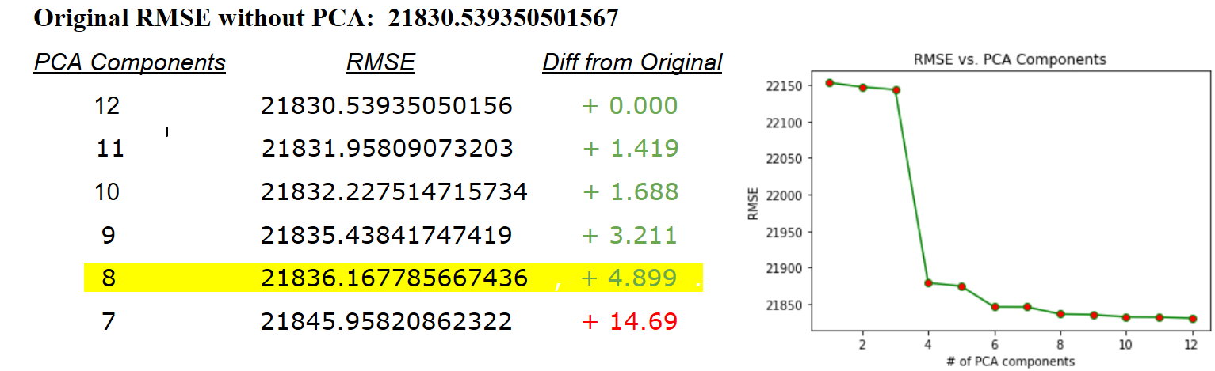
PCA on Linear Regression
These were our results:

Slide 17
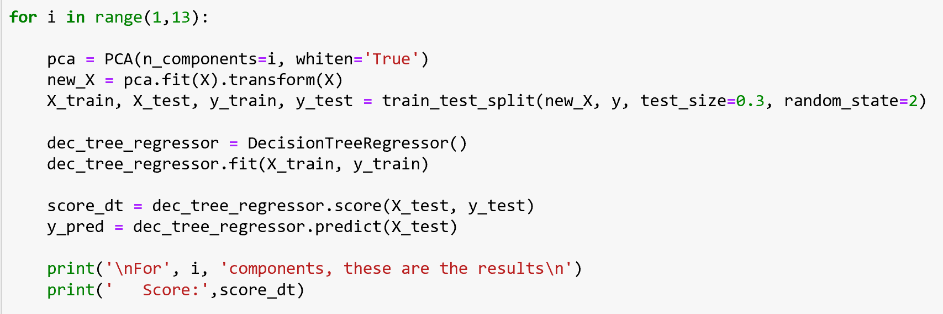
PCA on Decision Tree Regressor
The performed PCA as shown below:

Slide 18
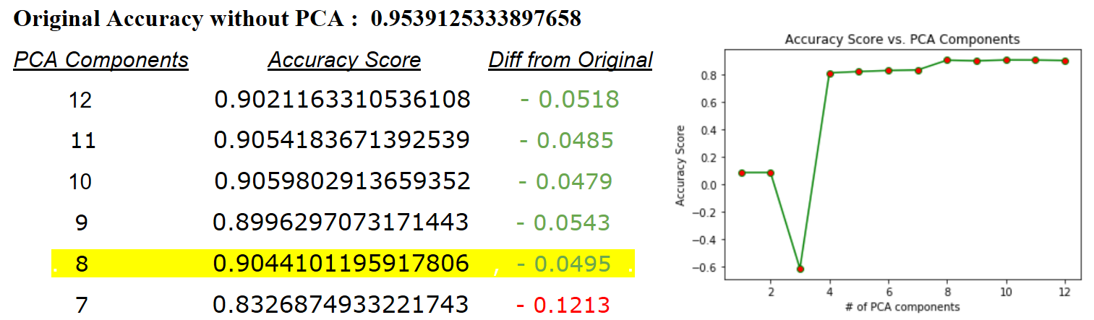
PCA on Decision Tree Regressor
These were our results:

Slide 19
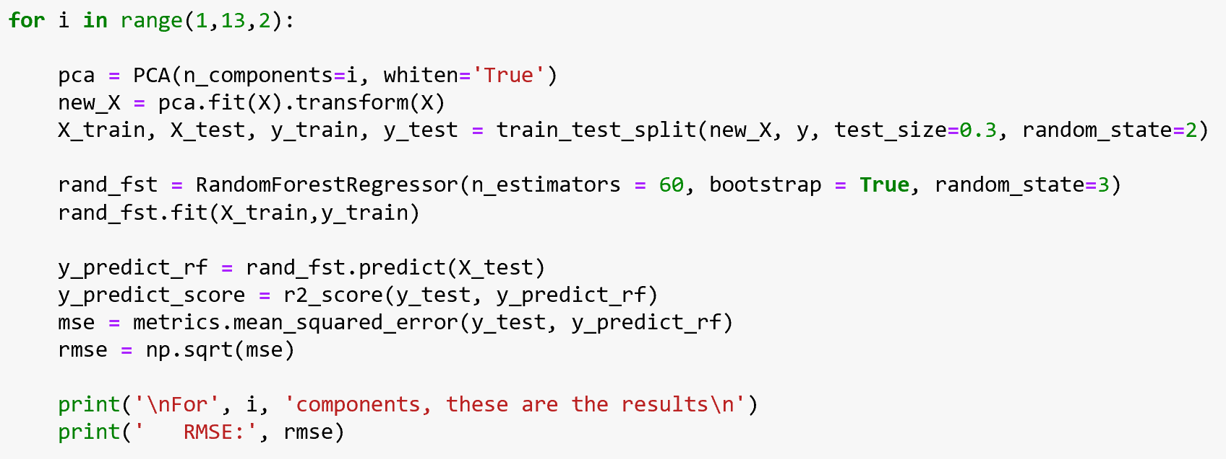
PCA on Random Forest
The performed PCA as shown below:

Slide 20
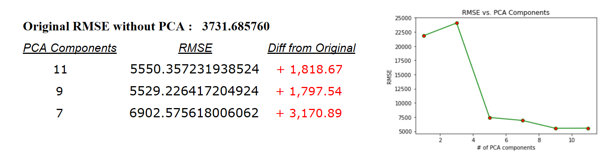
PCA on Random Forest
These were our results:

Slide 21
Conclusion:
The best Machine Learning algorithm we tested on this data set, was Random Forest
Random Forest composed of 60 trees was our best predictor
Random Forest, without PCA, gave us the lowest error of around 3.7k.

Slide 22
If you’d like to view our code, visit the link below
https://github.com/jesus-r-mendoza/Walmart-Store-Sales-Forecasting/

Slide 23
Thank you

